Slide 1
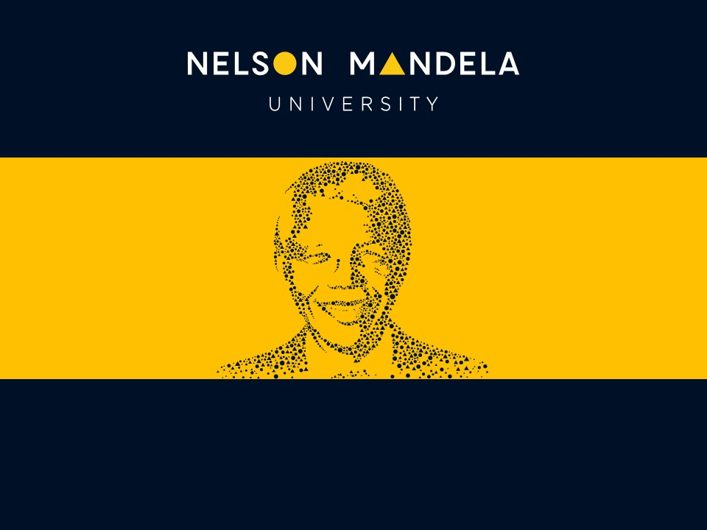
By Matita Tshabalala
FROM HEAD COUNT
TO HEART COUNT
Re humanising organisations after the pandemic
Industrial and Organisational Psychology Department
Notes:
Welcome and thank you to Nelson Mandela University for hosting this conversation. My argument today is simple: the pandemic taught organisations to count people, and it is time we taught them to see people again. I will show you what the counting mindset looks like, what it costs, what the latest research says, and five practices that reverse it.

Slide 2

THE QUESTION
When did the human leave human resources?
1
Listen to our language
Head count. FTEs. Human capital. Resources. Redundancies. The words reveal the mindset: people counted, optimised and reduced as units of production.
2
The pandemic did not create this
It accelerated it. Distance made it easier to see tiles on a screen instead of the lives behind them, and crisis made it acceptable to decide about people without people.
3
And people have noticed
Around the world, employees describe feeling monitored, measured and managed, but not seen, heard or valued as human beings.
14
Notes:
Set the provocation. Our vocabulary betrays us: we manage head count, not hearts and minds. The pandemic did not invent the counting mindset, but remote work, crisis decisions and economic pressure normalised it. Ask the room: when last did your organisation ask how well its people are, rather than how many?

Slide 3
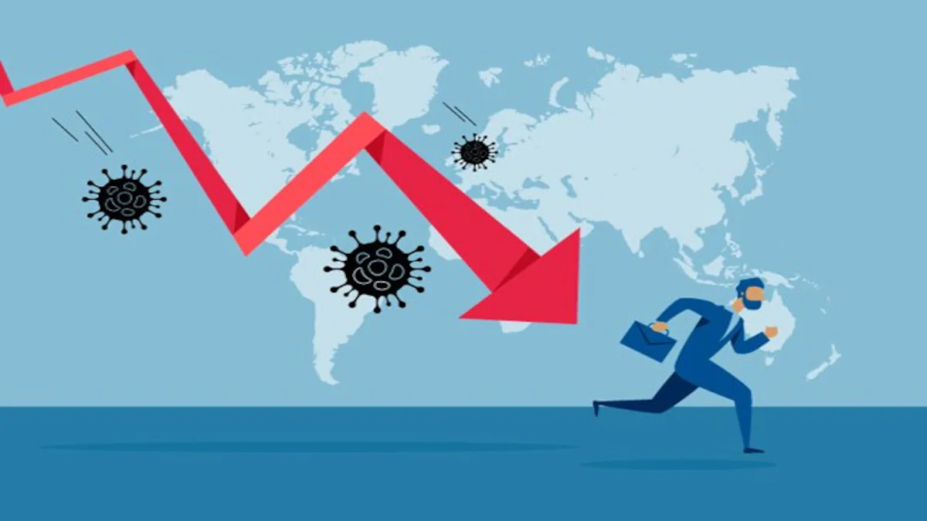
HOW WE GOT HERE
Three shifts the pandemic accelerated
1
Distance
Work moved onto screens. Colleagues became tiles, cameras went off, and the informal human contact that builds relationships quietly disappeared.
3
Detachment
Restructuring happened at speed and at scale, often announced by email or one video call, with people reduced to rows in a spreadsheet.
2
Datafication
Dashboards, productivity scores and monitoring tools promised visibility. In many organisations they quietly replaced conversation with measurement.
14
Notes:
None of these shifts was malicious. Each solved a real problem under pressure. The danger is what they add up to: a management operating system in which people appear mainly as data, and in which it is possible to run an organisation without ever truly encountering a person.

Slide 4
THE PRESENT REALITY
What head count thinking looks like today
1
Watched, but not seen
Most large employers now use some electronic monitoring. Research links surveillance to felt dehumanisation and lower psychological safety, with no real performance gain.
62%
of employees worldwide are not engaged: present in body, increasingly absent in spirit.
Source: Gallup, State of the Global Workplace
2
Managed by algorithm
Systems now assign work, score performance and trigger discipline. Many workers cannot tell if they answer to a human or a machine.
3
Restructured by spreadsheet
Mass retrenchments announced by email or one video call. Careers ended in minutes, with dignity treated as an afterthought rather than a design principle.
4
Wellbeing washing
Wellness perks on the surface, while workload, staffing and job insecurity, the real drivers of distress, remain untouched.
4
Notes:
Four patterns, all defended in the name of efficiency. The monitoring research is striking: studies find no reliable performance gain, but more distrust and a felt experience researchers describe as being watched but not seen. That phrase captures the whole problem.

Slide 5
THE SCOREBOARD
The human cost is now visible everywhere
20%
$438bn
22%
33%
of employees worldwide are engaged at work, down from 23 percent in 2022 and still falling (Gallup, 2026)
estimated productivity lost to disengagement in a single year across the world economy (Gallup, 2025)
of managers are engaged, down from 30 percent two years earlier: the carriers of culture are running empty (Gallup, 2026)
of employees say they are thriving in their lives overall: two out of three are not (Gallup, 2025)
5
Notes:
Gallup runs the largest ongoing study of the employee experience. Note the irony: engagement peaked in the crisis years, when leaders had no choice but to focus on people, and it has fallen every year since the counting resumed. The manager collapse matters most: the people expected to carry culture are the most depleted.

Slide 6
THE SAY DO GAP
Leaders believe it. Workers do not feel it.
81%
12%
41%
27%
of executives say human sustainability is very or critically important to their organisation (Deloitte, 2024)
of executives say their organisation is actually leading in this area (Deloitte, 2024)
of workers agree that their organisation is advancing human sustainability at all (Deloitte, 2024)
of workers say their employer is making progress in creating value for them as people (Deloitte, 2024)
5
Notes:
This is not a story of villains. Executives genuinely believe human sustainability matters, but belief without practice reads as hypocrisy from below. Deloitte names the default model an extractive approach: maximise the value taken from people while minimising what is invested in them. Closing this gap is the leadership work of the decade.

Slide 7
RECENT RESEARCH · THE EVIDENCE OF HARM
Being treated as a number is a measurable injury
1
It now has a name
Organisational dehumanisation: the experience of being treated as a tool and denied personhood by your organisation (Caesens and Stinglhamber, 2019).
2026
researchers found that dehumanising management drives severe burnout and a collapse in collaboration, and called for human centric leadership.
Source: Portland State University study, 2026
2
The damage is documented
Studies link it to exhaustion, silence, knowledge hiding, withdrawal and intention to leave.
3
Surveillance deepens it
Monitoring studies describe employees who are watched but not seen, tying electronic monitoring to felt misrecognition and mechanistic dehumanisation (Sociology, 2026).
4
Fairness programmes are not enough
Dehumanising management strips agency, and standard fairness initiatives fail to protect people from it.
4
Notes:
This is the first of two research slides. Organisational psychology now treats feeling like a number as a formal, measurable construct with over a decade of studies behind it. The 2026 Portland State finding is the headline: dehumanising treatment produces severe burnout and breaks collaboration, and fairness or wellness programmes on their own do not protect people. The cure has to be human centric management itself.

Slide 8

A LESSON FROM MY WORLD
Aviation learnt this the hard way
THE OLD VIEW: HUMAN AS HAZARD
Count the errors and find someone to blame
Add controls, checklists and surveillance
Design the human out of the system
Treat people as the problem to be managed
THE NEW VIEW: HUMAN AS ASSET
People create safety and success every day
Human adaptability is the intelligence of the system
Understand normal work, not only failures
Build just culture, trust and honest reporting
17
Notes:
This is my home territory. Aviation once blamed the pilot, the controller, the engineer, and safety stagnated. Progress came when we accepted that people are not the hazard to remove but the adaptive capacity that makes complex systems work. Human resources is standing exactly where safety science once stood: it must stop treating people as the number to reduce and start treating them as the asset to grow.

Slide 9
THE ALTERNATIVE
Heart count: five things every employee is silently asking for
5. Mattering
Valued as a person who adds value
4. Growing
Developing, not only producing
3. Belonging
Connected to a team that cares
2. Safe
Able to speak up without fear
1. Seen
Known beyond the job title
Heart count treats people as whole human beings, not units of capacity. Head count asks how many. Heart count asks how well.
18
Notes:
Heart count is not a soft alternative to performance. It is the condition for performance. These five needs build on each other, and mattering sits at the top: the experience of being valued and knowing you add value. Ask the audience which of the five is weakest in their organisation right now.

Slide 10

Umuntu ngumuntu ngabantu.
A person is a person through other people.
The Ubuntu philosophy. An organisation is only as human as the way it treats its people.
21
Notes:
We do not need to import this philosophy. Ubuntu has always taught that personhood is relational. Re humanising the workplace is, in a deep sense, an African idea coming home. Pause here and let the room sit with it.

Slide 11
THE SHIFT
From head count to heart count
1
Capacity, not cost
Grow people as capacity instead of minimising them as a cost on a line.
2
Trust, not surveillance
Clear expectations and earned trust instead of monitoring and control.
3
Conversations, not scores
Ongoing honest conversations instead of one annual engagement number.
4
Humane work, not perks
Redesign workload, staffing and rest instead of adding wellness apps at the edges.
5
Change with people
Involve people in change from the start instead of doing change to them.
6
Dignity in transitions
Exits handled face to face and with care instead of careers ended by email.
10
Notes:
None of the items being replaced is evil. Each is simply insufficient. The shift is not about spending more money: it is about redirecting attention. Trust is cheaper than surveillance, and a conversation is cheaper than a disengaged resignation.

Slide 12
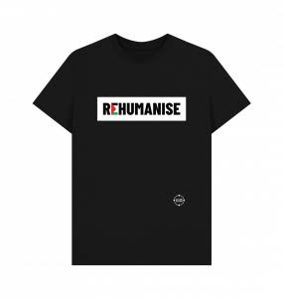
THE PLAYBOOK
Five practices that re humanise an organisation
1
See the person
Leaders who know their people beyond the job title, present in the work, not merely informed by dashboards.
2
Design humane work
Workload, staffing, rest and recovery planned around human limits. Fatigue is a system risk, never a personal weakness.
3
Build safety to speak
Psychological safety and a just culture, where people can raise problems and admit error without fear.
4
Care in the hard moments
Restructuring, discipline and crisis handled with honesty and dignity, supported by peer support programmes.
5
Count what is human
Trust, belonging, energy and the quality of exits measured with the same seriousness as output and cost.
52
Notes:
These five practices come directly from human factors work in aviation and from organisational psychology. They are not a wellness programme. They are an operating model: presence, humane design, safety to speak, dignity under pressure, and measurement that includes the human.

Slide 13
RECENT RESEARCH · WHAT WORKS
The science of feeling counted
1
Mattering is a leadership skill
Noticing people, affirming their significance and showing how they add value is teachable, and predicts motivation, wellbeing and retention (Mercurio, HBR Press, 2025).
39%
of employees strongly agree that someone at work cares about them as a person. About three in ten report feeling invisible.
Source: Harvard Business Review, 2025
2
Belonging pays
Organisations investing in belonging are 54 percent more likely to report strong revenue growth (McLean and Company, 2025).
3
Psychological safety protects
A three wave study of frontline employees found team psychological safety weakens the link between mistreatment and feeling dehumanised.
4
Recognise the person, not only the output
Recognition for character and effort, not just results, predicts more meaning, cohesion and lower burnout.
4
Notes:
The second research slide: the good news. Feeling counted is not a mystery; it is a science. Mattering can be taught, belonging shows up in the revenue line, psychological safety buffers people against dehumanising experiences, and recognising the person rather than only the output changes how people see themselves. The 39 percent figure is the opportunity: most people are one caring leader away from a different working life.

Slide 14
Where the change begins
1
Leaders
Walk the floor, physical or virtual. Ask how people are doing, then visibly act on the answer. Model rest, boundaries and honesty.
2
HR and OD
Rebuild the psychological contract. Run change with people, not on them. Retire language and metrics that reduce people to resources.
3
All of us
See the colleague before the task. Check in without an agenda. Challenge dehumanising habits, including your own.
Choose one practice, one measure and one conversation to start this week. A commitment spoken aloud is four times more likely to survive.
51
Notes:
Re humanising is not a project with a budget line. It begins with behaviour that costs nothing: presence, listening, dignity, and the courage to challenge the language of resources. Give each group in the room one thing they can do this week, and invite two or three people, in the room and on the platform, to say theirs aloud.

Slide 15
MEASUREMENT
Measure heart count like you measure head count
1
Trust in leadership
Tracked openly over time and reported to the board alongside the financials.
2
Known as a person
The share of people who agree: my manager knows me as a person.
3
Safety to speak
Psychological safety measured and owned at team level, not averaged away.
4
Fatigue and recovery
Workload, rest and recovery indicators treated as system risks.
5
Dignity in exits
Quality of exits and alumni sentiment: how people leave tells the truth.
6
Manager capacity to care
Managers shape about 70 percent of team engagement, yet fewer than half are trained to lead people (Gallup).
10
Notes:
What gets counted gets attention. If humanity is not on the dashboard, it will not be on the agenda. These six measures are practical and already in use in mature safety cultures. The single best investment is the manager: seventy percent of engagement variance sits with them, yet most have never been taught how to care at scale.

Slide 16
“
In twenty years in aviation I never met a safe system that treated its people as numbers. Organisations do not run on head count. They run on human beings who feel counted.
“
Matita Tshabalala
Aviation Psychologist · IO Psychologist · Human Factors Specialist
53
Notes:
Deliver this slowly, as the landing. Then bridge to thanks and questions.

Slide 17
Thank you
54
Notes:
Questions from the room first, then from the platform. If questions run dry, seed with: which of the five practices would be hardest in your organisation, and why? Offer follow up contact and thank the university host by name.

Slide 18
FOR THE CURIOUS
Sources & further exploration
Gallup, State of the Global Workplace (2025 and 2026 editions): engagement, wellbeing and manager data
Deloitte, Global Human Capital Trends (2024): human sustainability and the extractive approach
Caesens, Stinglhamber and colleagues: research programme on organisational dehumanisation (2017 to 2026)
Jansen, Noorda, Akkerman and Manevska (2026), 'Watched but Not Seen', Sociology: monitoring and misrecognition
Zhang and colleagues (2025), 'The Rise of Algorithmic Management', New Technology, Work and Employment
Mercurio, Z. (2025), The Power of Mattering, Harvard Business Review Press; McLean and Company (2025) on belonging
Edmondson, A. (2018), The Fearless Organization: psychological safety as the foundation of learning
Facilitator's research: Tshabalala, 'Occupational stress and coping resources in air traffic control', Ergonomics SA (2014); chapter in Mistakes, Errors and Failures across Cultures (2020)
55
Notes:
Leave on screen during informal conversation after close. Point to your own published research last: it earns credibility without boasting.

