Slide 1

HEADCOUNT → HEARTCOUNT
Rehumanising Organisations in a Post-Pandemic and AI-Enabled World

Slide 2
HEADCOUNT → HEARTCOUNT
Question
What will determine organisational success over the next decade?
Technology?
AI?
People?

Slide 3
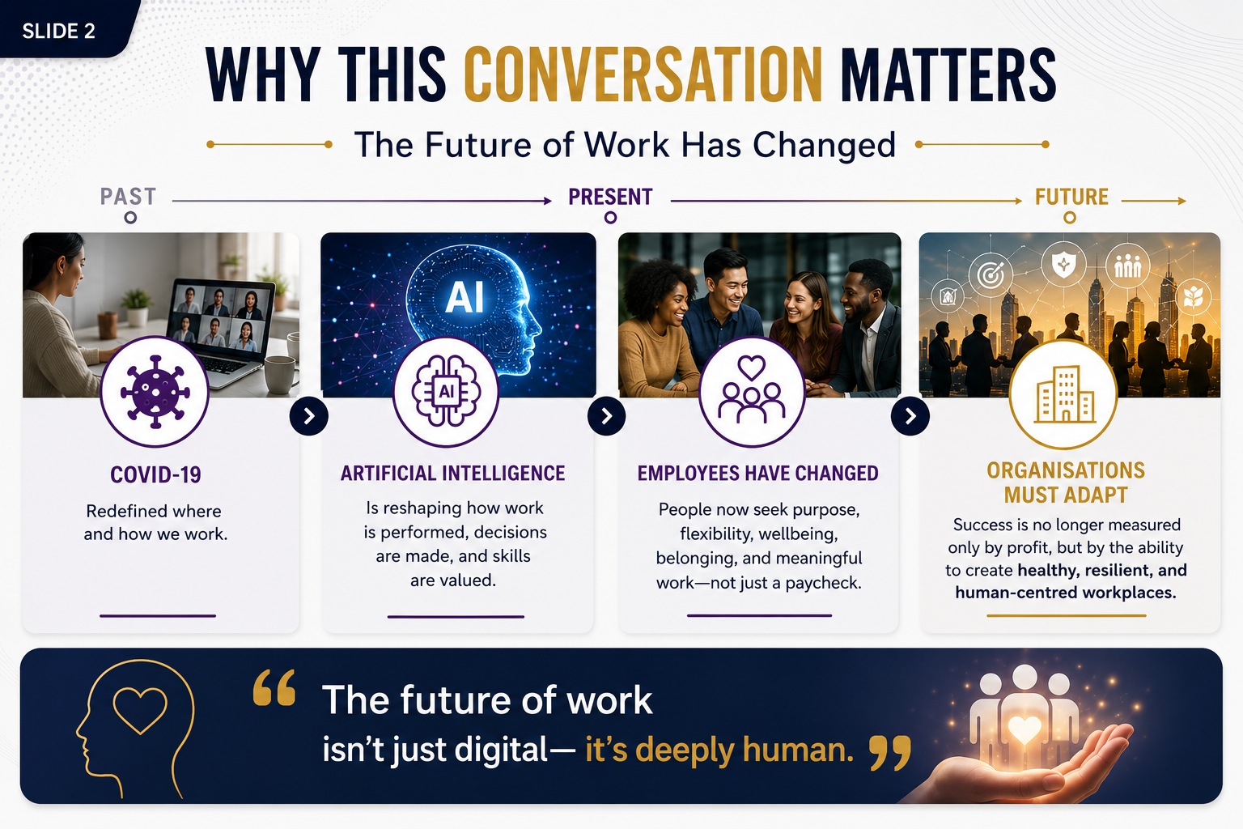
HEADCOUNT → HEARTCOUNT
Why This Conversation Matters

Slide 4
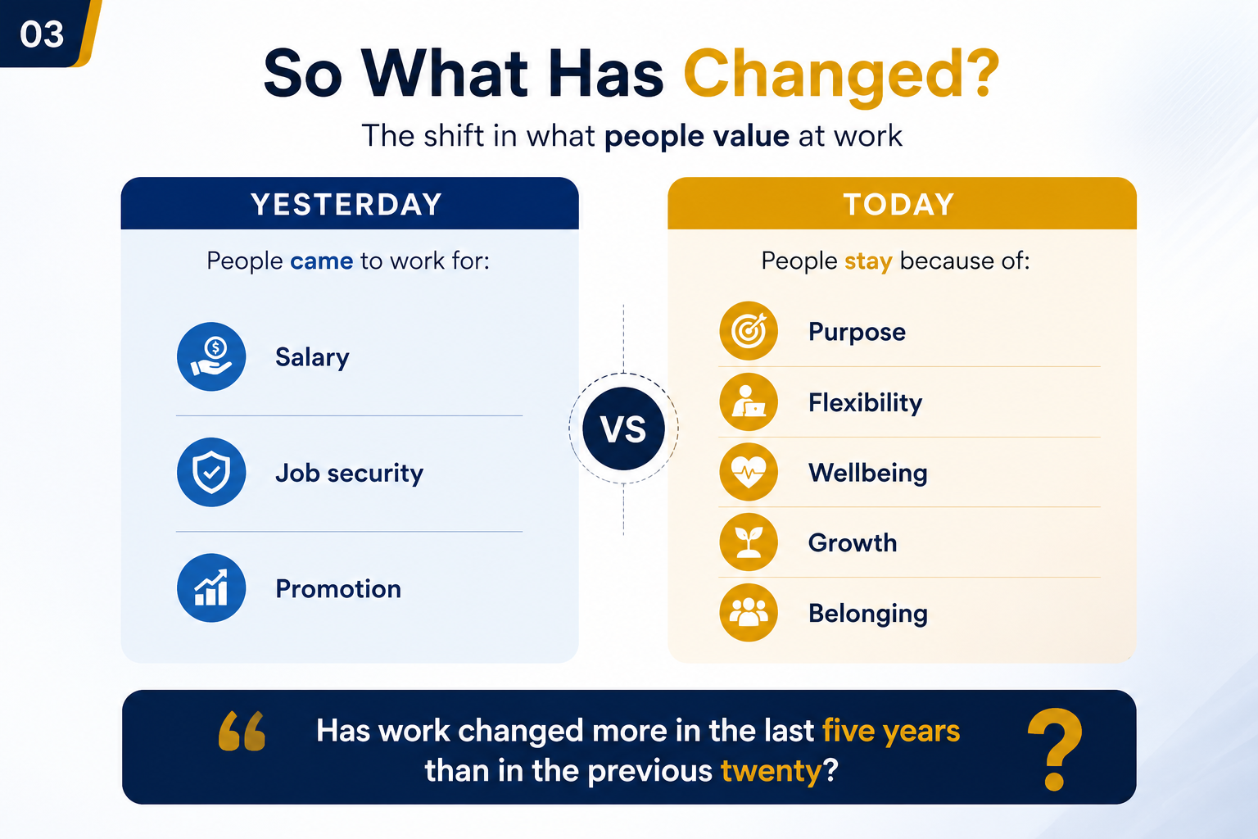
HEADCOUNT → HEARTCOUNT
So What Has Changed?

Slide 5
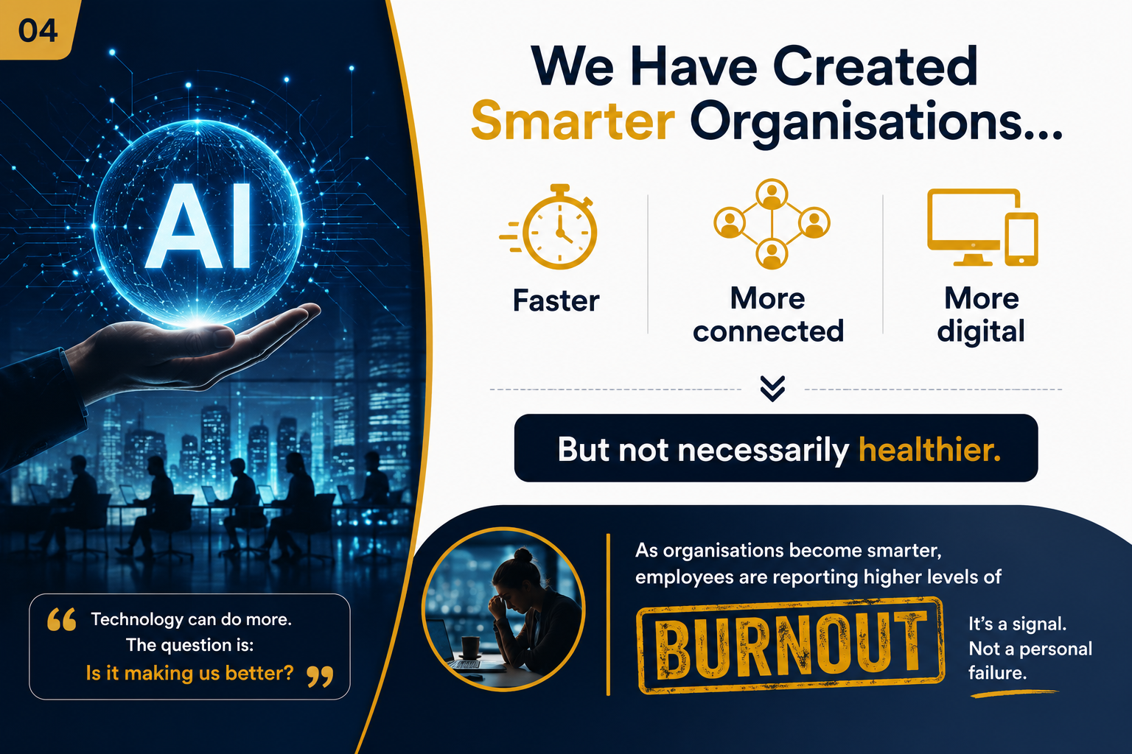
HEADCOUNT → HEARTCOUNT
We Have Created Smarter Organisations…

Slide 6
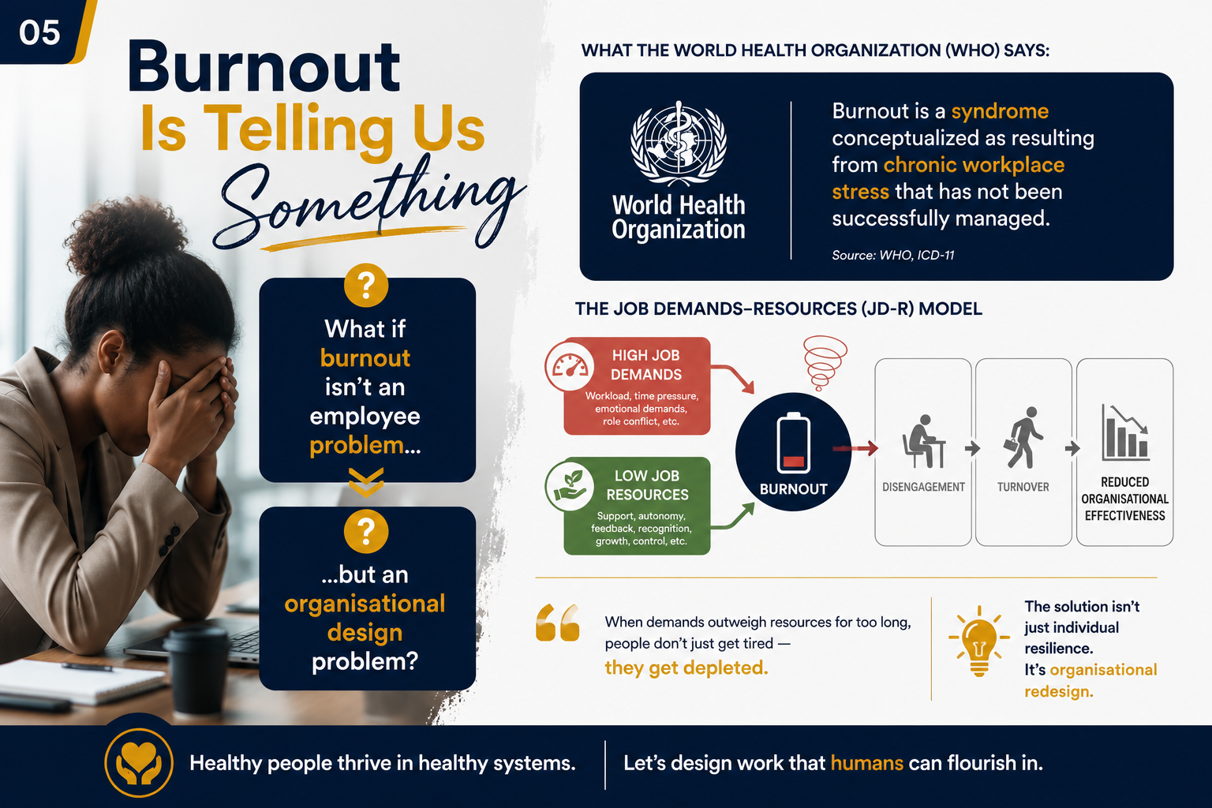
HEADCOUNT → HEARTCOUNT
Burnout Is Telling Us Something

Slide 7
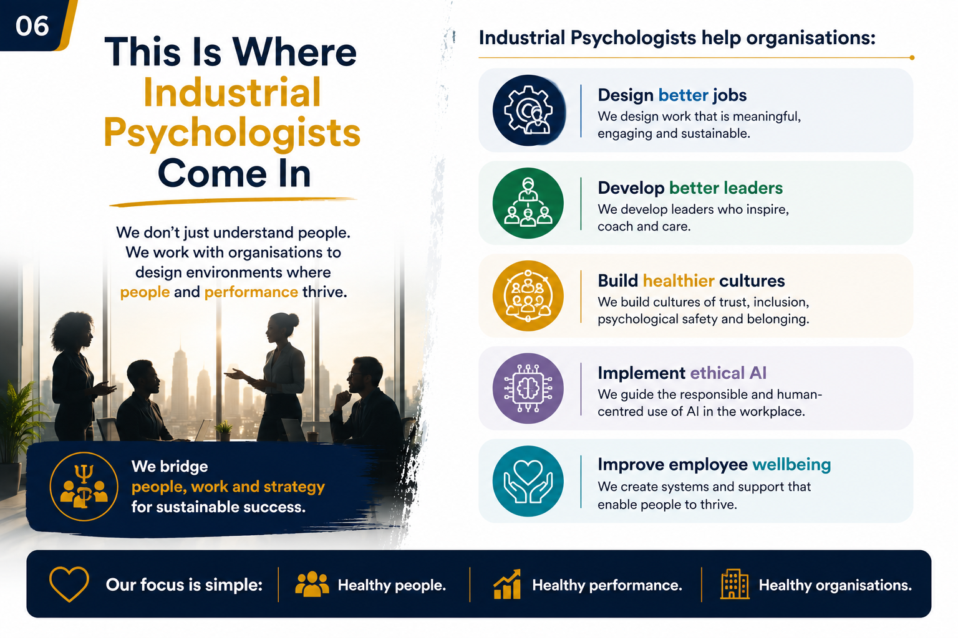
HEADCOUNT → HEARTCOUNT
This Is Where Industrial Psychologists Come In

Slide 8
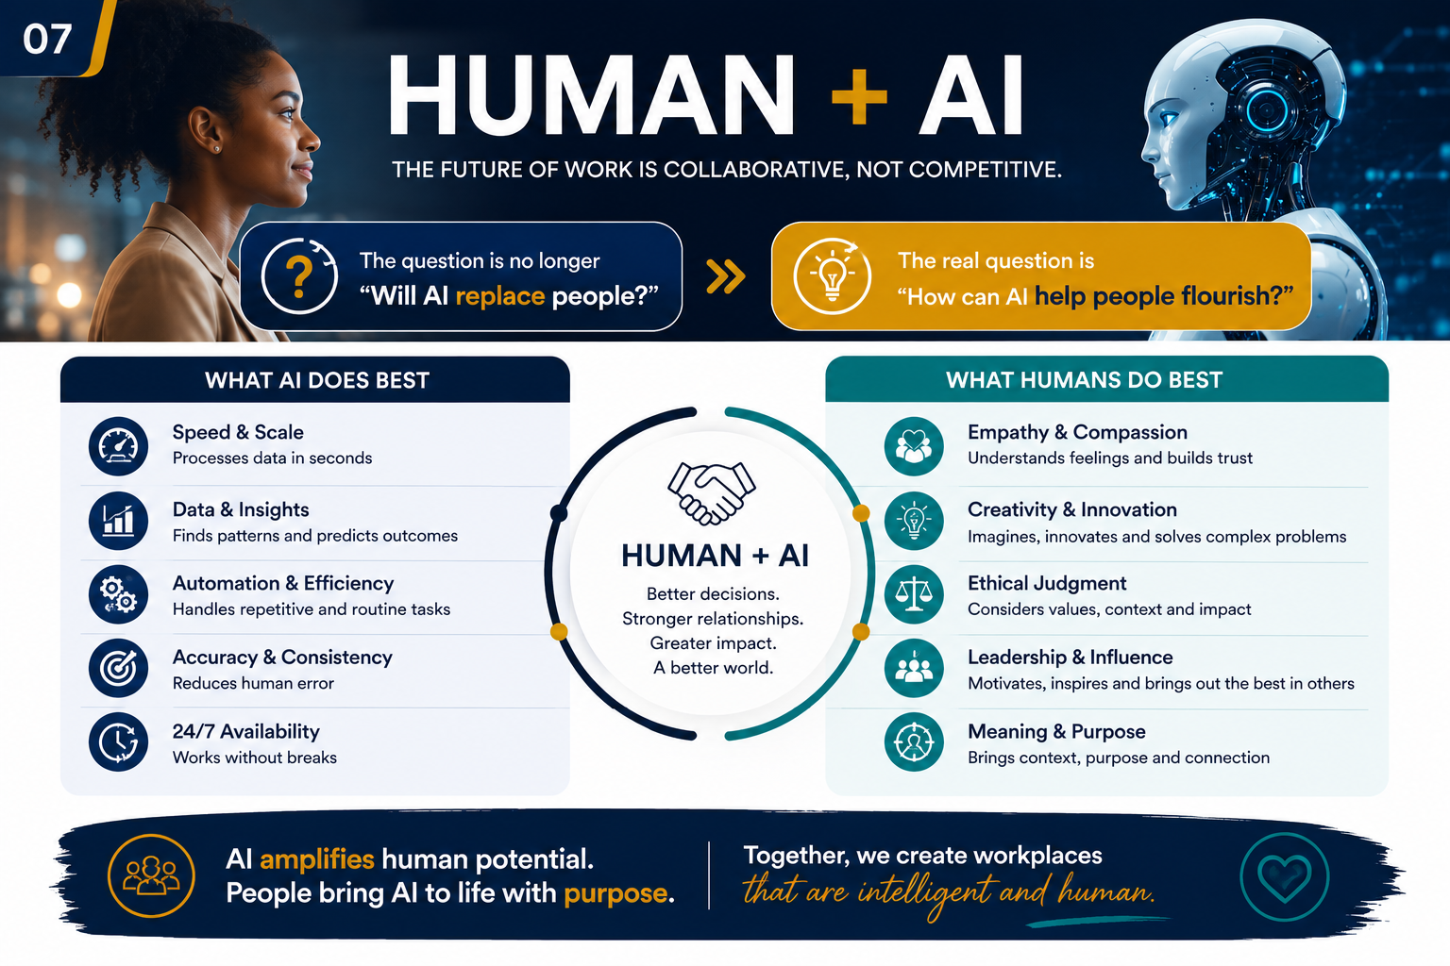
HEADCOUNT → HEARTCOUNT
Human + AI

Slide 9
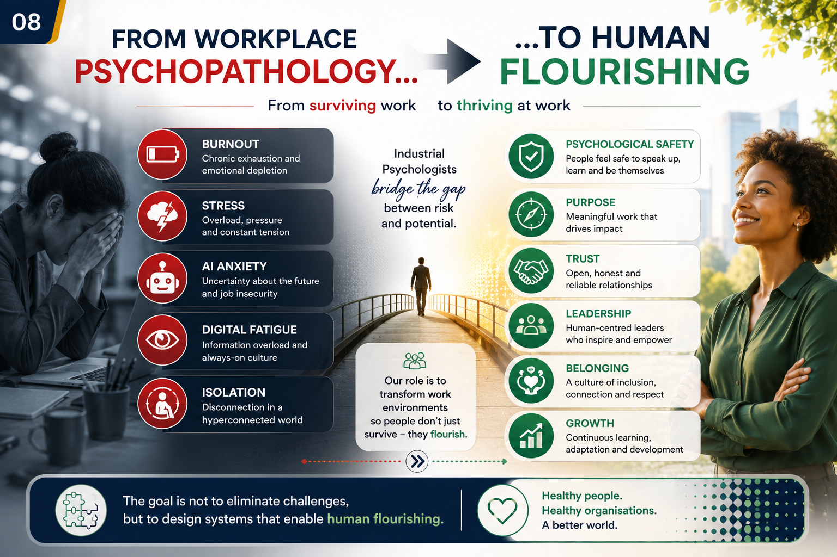
HEADCOUNT → HEARTCOUNT
From Workplace Psychopathology…

Slide 10
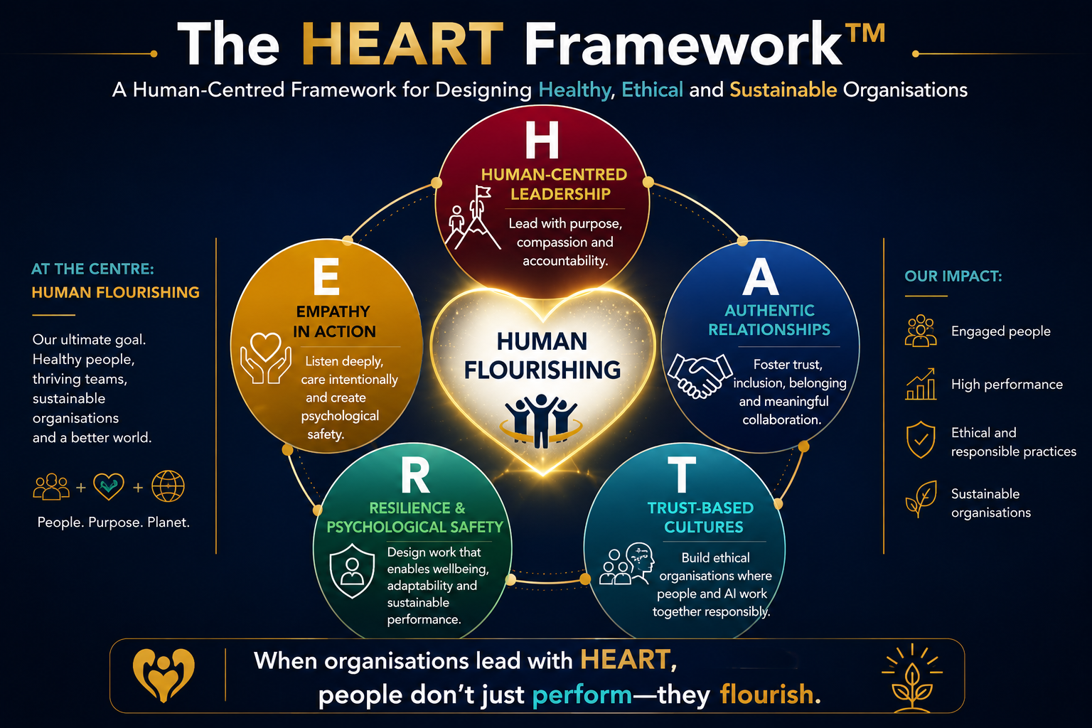
HEADCOUNT → HEARTCOUNT
So how do we rehumanise organisations?
The HEART Framework™

Slide 11
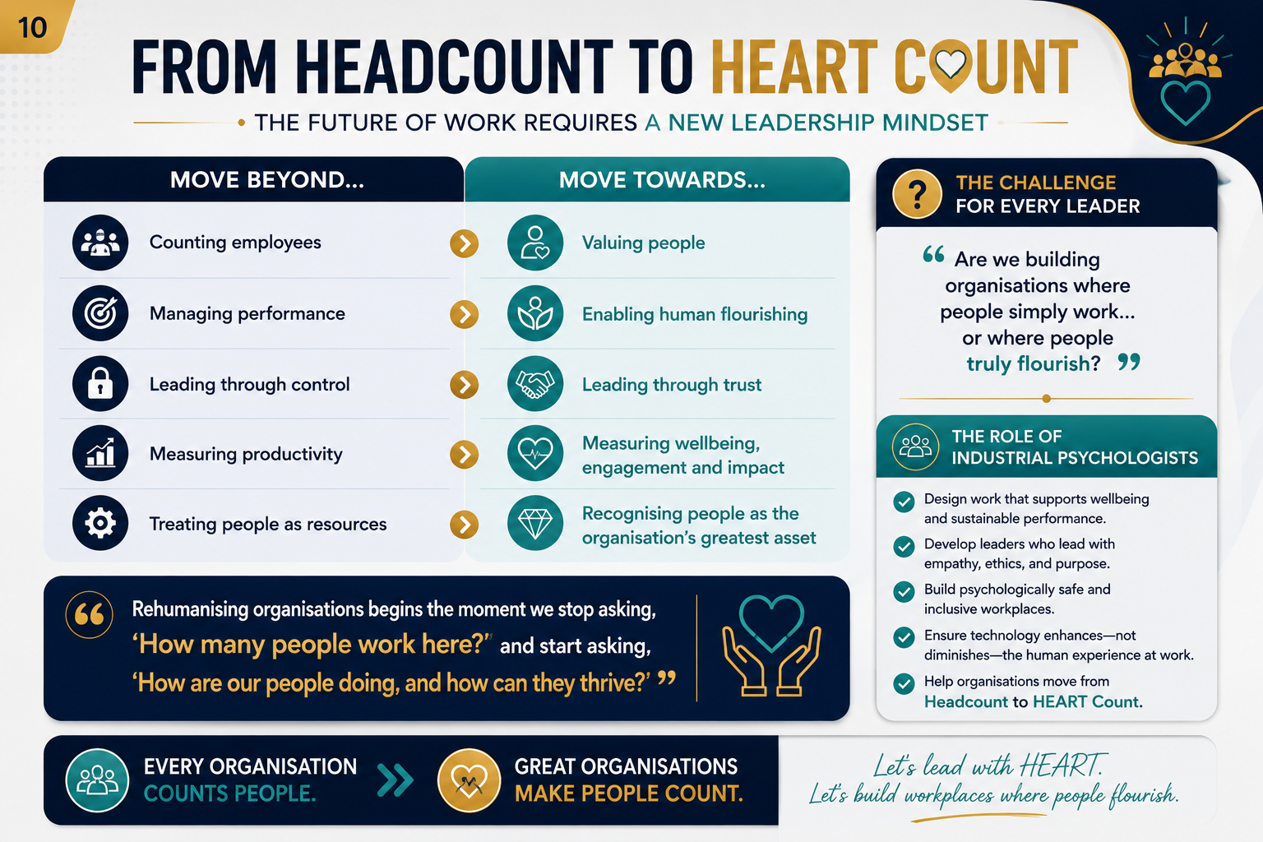
HEADCOUNT → HEARTCOUNT
From Headcount to HEART Count

Slide 12
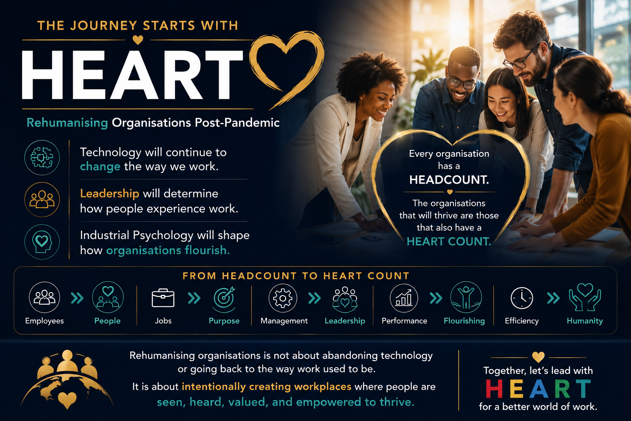
HEADCOUNT → HEARTCOUNT
The Journey Starts with HEART

Slide 13



